Slide 1
Digital safety 101
Protecting yourself and others in a digital world
Notes:
I’ve had the opportunity to work with children and families as they deal with some of the darkest moments they’ll ever have to deal with: when their child has become a victim of exploitation. I rarely deal with cases involving “hands on offenders” because of how the federal laws are written. Typically, federal prosecutors are only able to get involved when there is an “interstate nexus”, usually the use of the internet.
In my roles, I’ve had the opportunity to attend conferences and trainings to better understand how these crimes happen and how we can work together to try to prevent them from happening in the first place. While I love what I do and take pride in prosecuting these cases to the fullest extent possible, we simply cannot prosecute our way out of this problem. Because by the time someone like me gets involved, it’s often too late. It takes every single one of us coming together, like we are tonight, to protect our children, our families and ourselves from online threats.
My why/how. People often ask me “how can you work on those kinds of cases?” And my answer has always been the same. I never thought I’d work these kinds of cases. Starting out as a prosecutor, I had no desire to be a SVU prosecutor. But then I had kids. Working these cases, I’m able to help families but I’m also able to learn how to better protect my own family.

Slide 2

My goals for tonight
Educate
Provide a basic overview of the issues surrounding students (and adults!) and technology
Equip
Give you some tools and resources to help prevent harm before it happens
Empower
Show you how you can use those tools to help others if they become victims
Notes:
We live in a world today where the demand for instant access to information has us glued to devices and screens. The modern iPhone is tens of thousands of times faster, has millions of times more memory and storage, and costs a fraction of what the earliest personal computers cost. All while fitting into your pocket.
But with great power comes great responsibility (Spiderman fans?!). As a society, we have focused so much on making the latest and greatest product that we’ve overlooked vital safety guardrails, especially for children and teens. This has led to increased levels of anxiety and depression among our youth, adults and parents becoming addicted to their devices and online presence (doomscrolling) and a breakdown of normal face-to-face relationships (even at home).
That’s why we’re all here tonight. If tonight helps just one student/parent/family, then we’ve done our job.
Tonight, we’re going to touch on some of the big areas of concern surrounding the use of technology but we are only just scratching the surface. Tonight is just the first step in an ongoing process. You’re going to hear me refer to a lot of different resources tonight and we’ve compiled many of them that will be available to you online. First portion is going to be information heavy (data, stats, etc.); but bear with me, after a short break we’ll dive into some of the tools that already exist to help prevent harm so you can hopefully avoid having to deal with people like me (at least in a professional setting).

Slide 3

disclaimer
I do not have all the answers
There is no “one size fits all” solution
Thoughts, comments, etc. are my own
Notes:
Tonight I’m a father, uncle, brother, and son who just happens to have access to some information that can help.
I’ll say this numerous times tonight, but there is no magic button when it comes to dealing with technology in your family. Everything I talk about tonight are tips and advice that have been successful for others but you need to make decisions as a family to figure out what works best for you.
My wife can testify to the 3rd point.
Ground rules:
This is a judgment free zone, we’re all here for the same reason: protect our students (and ourselves) online
I’m going to be as open and honest with you as I can be
Be honest during audience participation
We’re going to be talking about some heavy stuff tonight. If you or someone you know is going through something related to this, please reach out (to parents, pastors, teachers, me, etc.). Because…

Slide 4
always remember…
You are not alone!
Notes:
Poll the audience:
Parents, what do your children do most online?
Students, what do your parents do most online?
Show of hands, who uses:
Instagram?
Facebook?
TikTok?
Snapchat?
Kik?
Discord?
YouTube?
Minecraft?
Roblox?

Slide 5
Online exploitation of children is continuing to increase rapidly
In 2025 alone, there were…
21.3 million reports of suspected child exploitation
1.4 million reports of online enticement/sextortion
Over 400,000 reports involving AI-generated exploitation
Notes:
National Center for Missing and Exploited Children (NCMEC) is a non-profit organization that was founded in 1984 by John and Reve Walsh and several other child advocates after the kidnapping and murder of their son Adam. Today, NCMEC serves as the national clearinghouse and provides a coordinated, national response to problems relating to missing and exploited children.
In 1998, NCMEC created the CyberTipline. The CyberTipline provides an online mechanism for members of the public and electronic service providers (ESPs) to report incidents of suspected child sexual exploitation. These “CyberTips” are then reviewed by NCMEC staff who refer them to local/state/federal/foreign law enforcement depending on the location of the incident being reported. A lot of the cases we work on the federal level start out as a CyberTip.
Every year, NCMEC publishes a report of CyberTipline statistics from the previous year and highlights trends from that data. This helps law enforcement identify new techniques being used by offenders and allows them to adjust their investigative methods accordingly.
This includes over 55 million files of suspected CSAM being reported to NCMEC
If each file was represented by a sheet of paper, they would cover the surface of a football field … 620 times
1.4 million reports – 156% increase over 2024 numbers
Sextortion - the threat to expose a sexual image in order to make a person do something or for other reasons, such as revenge or humiliation. Can be financially motivated or used as a tool to gather more images.
In 2025, NCMEC received an average of 137 reports of financial sextortion a day – a 37% increase in reports daily compared to the year before.
1 in 6 of those financial sextortion cases involved discussion of self-harm or suicide.
Tragically, NCMEC is aware of at least 36 teenage boys in the U.S. who have taken their own lives as a result of being victimized by this crime.
The progression of threats in sextortion cases, including those resulting in suicides, is often rapid, usually occurring within the first few hours of contact. They are designed to pressure kids to pay up before they have time to properly process the threats or seek help.
As of Saturday, August 8, the CyberTipline has already processed 21.1 million reports in 2026, including 831,000 just last week alone.
1.4 million of those are reports of online enticement/extortion

Slide 6
What kids are experiencing online
Early exposure to explicit content (often before age 12)
Requests for nude photos or personal information
Contact from strangers posing as non-threatening “friends”
Pressure to engage in sexual conversations or meet in person
Threats of extortion after nude images are shared or created
Notes:
The average age that children are first exposed to pornography is getting younger and younger (currently right around age 12). At the same time, the rates of violence in pornography is also increasing so what kids are seeing is becoming more extreme. A lot of younger kids are exposed unintentionally but it’s still harmful.
Most of these interactions start off as online “friends” and then escalate, often at a rapid pace.
Study after study shows that a majority of youth who become victims of sextortion don’t report it because of embarrassment, shame and fear that they are to blame. Historically speaking, financial sextortion was rare (less than 10% of reported cases) but the rates are rising, specifically in the category of boys 14-17 years old. While there are various categories of offenders in the sextortion category (ex-romantic partners trying to force someone back into a relationship or trying to seek revenge, cyberbullying, etc.) one of the trends that we see specifically in the financially-motivated sextortion category is that the offenders are located overseas. These groups tend to target teens who are publicly successful (top academics, successful athletes, college scholarships, etc.) because they can leverage the fear of losing that success by exposing the nude images. Teens become desperate and try to negotiate their way out of the situation, often by paying some or all of the financial demand, but the offender almost never holds up their end of the agreement and either continues the threats/extortion or releases the images anyway.

Slide 7
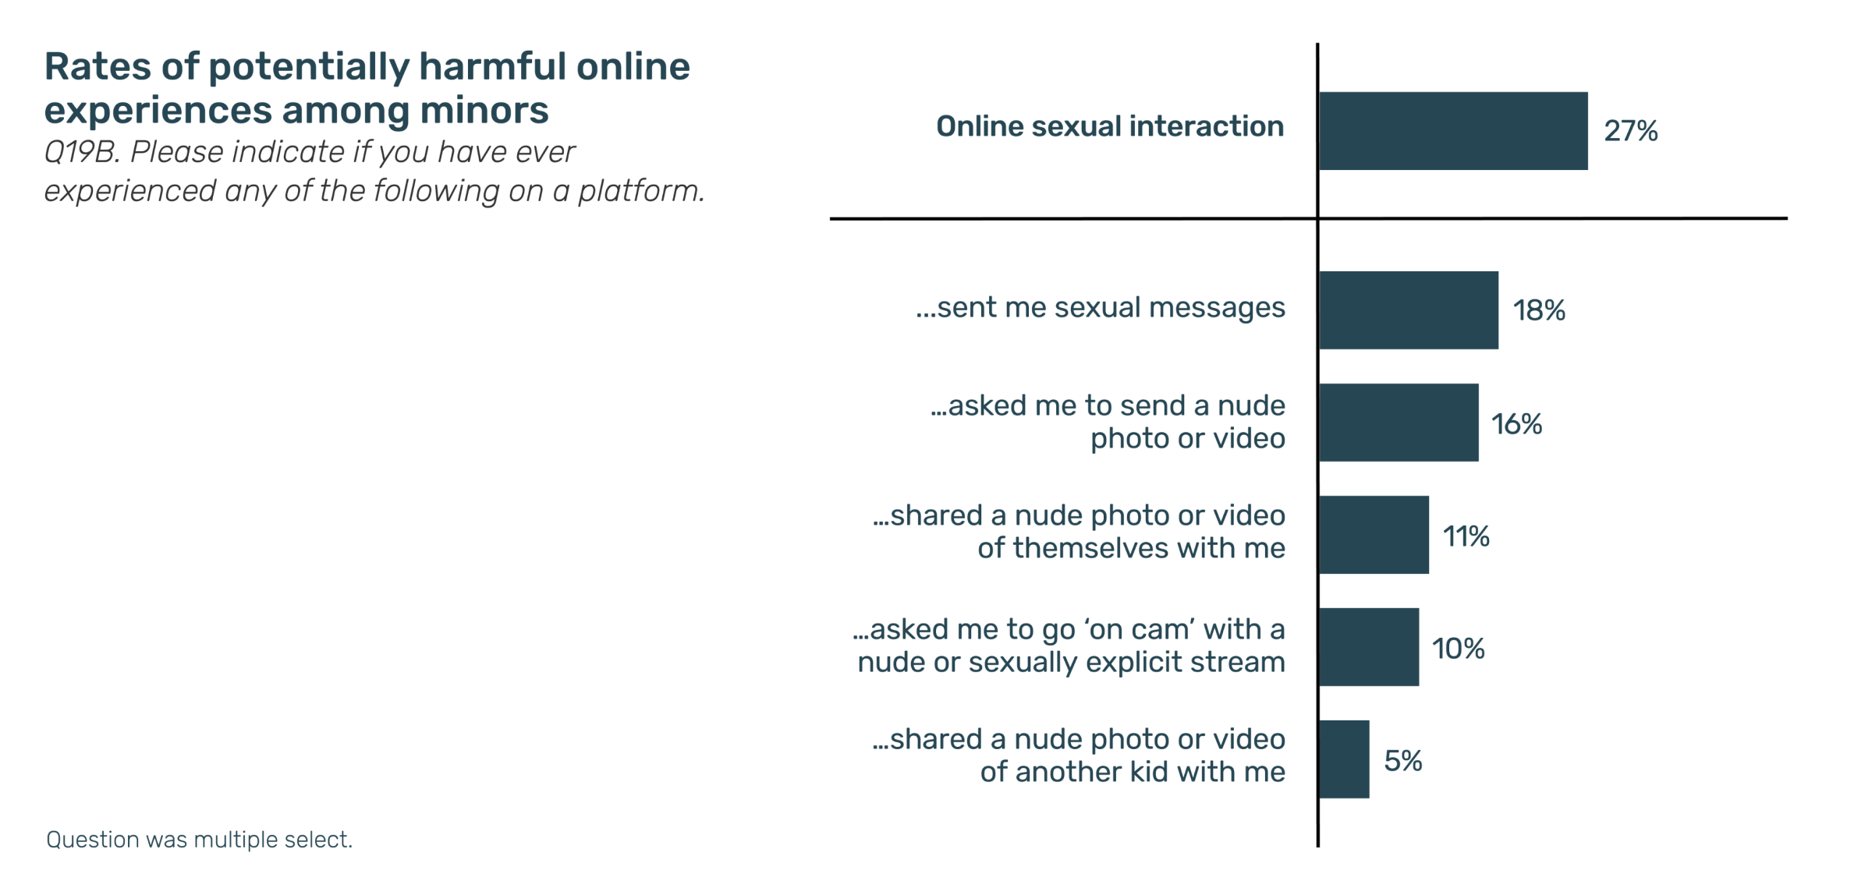
What do the numbers tell us?
51% of minors reported they had a potentially harmful online experience
Notes:
Thorn’s (another non-profit organization dedicated to identifying and rescuing child victims and combating this issue from multiple angles) annual survey of minors nationwide (1,003 minors 9-17 years old surveyed in Nov-Dec 2025).
Roughly 271 kids experiencing online sexual interactions in this survey
Roughly 160 kids who were asked to send a nude photo or video
100 kids who were asked to go live on camera

Slide 8
How does this happen?
Connecting with friends – and strangers
Downloading apps and joining new platforms
Sharing photos, videos, and other personal details
Building a digital identity/footprint earlier and younger
Notes:
Common tactics include:
Platform shifting (Let’s move over to Discord)
Isolation (Don’t tell your parents; they wouldn’t understand)
Desensitization (Gradual introduction of sexual and/or violent topics)
Control & Coercion (Threats, guilty, blackmail)
Warning signs:
Secretive about gaming or devices
Sudden new “online friend” they won’t explain
Increased anxiety, withdrawal, or irritability (especially if they can’t use their device)
Receiving gifts, game currency, or perks from unknown users or without explanation

Slide 9
Where does this happen?

Slide 10


























Where does this happen?
Notes:
It is literally anywhere that communication can occur. The old “stranger danger” of the creepy guy driving a sketchy van around the neighborhood has morphed into the adult on the other side of a screen inside your house (or possibly your child’s bedroom).
This issue is generally even across demographic types. It crosses ethnic and racial lines. Doesn’t care if you’re wealthy or poor. Big city vs. country. Etc. Living in a more rural area, we sometimes feel like we’re removed from these “big world problems” but it’s a false sense of security and we have to be aware of that.
ENCRYPTION – More and more apps and platforms are moving to end-to-end encryption of their data, meaning that unless you have the “key” from at least one of the users, you can’t access the data from the provider themselves. While this increases privacy for users, it makes it more difficult for law enforcement to investigate.
Youth Perspectives on Online Safety, 2025 (Thorn, July 2026):
- In 2025, almost half (47%) of all minors surveyed said they accessed an app, website, or platform before they met the minimum age requirements.
- Teens (50%) were more likely to report doing so than preteens (43%). Boys (51%) were more likely than girls (43%).
- Among minors who said they got around age limits, the most common ways were:
Misrepresenting their age, like using a fake birthday (63%)
Getting someone older to help them make their account (19%)
Using a shared account (16%)
Using someone else’s information such as an email or phone number to gain access (14%)

Slide 11

United states v. MICHAEL dendy
Charges:
  Sexual Exploitation of a Child (Production of Child Pornography) – 5 counts
  Distribution of Child Pornography – 7 counts
  Receipt of Child Pornography – 8 counts
  Possession of Child Pornography – 1 count

Slide 12
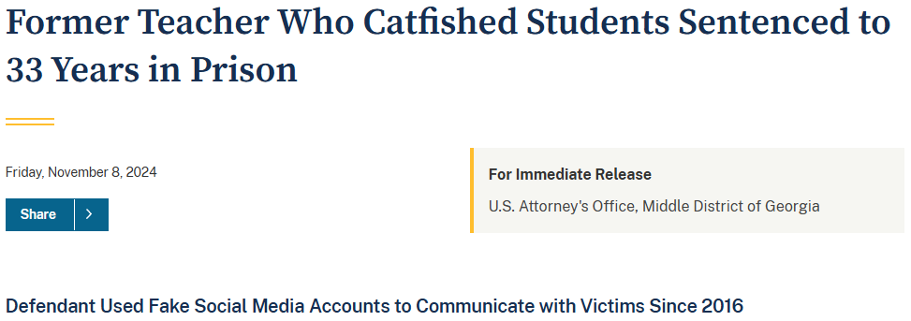
United states v. MICHAEL dendy
Charges:
  Sexual Exploitation of a Child (Production of Child Pornography) – 5 counts
  Distribution of Child Pornography – 7 counts
  Receipt of Child Pornography – 8 counts
  Possession of Child Pornography – 1 count

Slide 13
United states v. MICHAEL dendy
Charges:
  Sexual Exploitation of a Child (Production of Child Pornography) – 5 counts
  Distribution of Child Pornography – 7 counts
  Receipt of Child Pornography – 8 counts
  Possession of Child Pornography – 1 count

Slide 14
If they can access you, they can study you
Kids often think:
  “It’s just online, not real life.”
  “Everyone else has public profiles.”
  “We have mutuals; play the same games.”
  “My data is already out there anyway.”
Strangers can learn about you quickly through your online info
Online access is real world risk
Notes:
We heard this regularly from the victims in the Dendy case (“I didn’t know them, but we had mutual friends and they talked like they went to my school, so I assumed it was a friend of a friend.”)

Slide 15
Key risk factor: your digital footprint
A “digital footprint” is anything that is shared online
  Messages; Posts; Comments; Photos
  Likes; Follows; Interests
  Location Data
  Tags; Content Shared by Others
Anything posted online should be treated as potentially permanent, and potentially public; whether you intend it or not.
Notes:
Even posting innocent images online publicly can lead to harm (can be used with AI tools to generate harmful images)

Slide 16
AI: Artificial intelligence or absolute insanity?
Generative AI
Allows a user to create new images, videos, audio and text based on user requests or prompts
AI Chatbots & Companions
Computer program designed to simulate conversation with human users, especially over the internet

Slide 17

Generative ai
Notes:
Picture 1: Aurora
Top: GAI
Bottom: Authentic
Picture 2: Women's Faces
Top: GAI
Bottom: Authentic
Picture 3: Nature
Top: Authentic (yellow flowers)
Bottom: Authentic (leaves)

Slide 18
Generative ai
“Nudify” type apps are being used by offenders and students
NCMEC received over 400,000 reports of child exploitation involving GAI in 2025 alone
  More than 182,000 of those reports involved offenders possessing, generating or attempting to generate GAI CSAM
Since 2023, NCMEC has identified more than 275 victims of GAI CSAM, and more than 158,000 images/videos have been categorized
Notes:
Roughly 10% of financially-motivated sextortion reports filed last year involved images that were not authentic (AI generated/modified)
Thorn: 1 in 10 minors reported that their friends or classmates had used AI tools to generate nudes of other kids
GAI has also been linked to thousands of hoax bomb threat calls, swattings, financial scams, etc.; not just a CSAM problem.

Slide 19
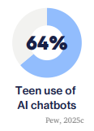
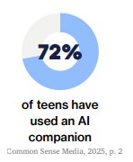
AI Chatbots & Companions
Notes:
Thorn, Youth Perspectives on Online Safety, 2025:
-More than 1 in 4 (29%) said they used these tools for private or personal reasons, like getting advice about romantic feelings (21%) and finding information about puberty or sexual health (18%).
-Almost 1 in 3 (30%) minors said they turned to AI chatbots or companions when something confusing or upsetting happened to them or someone else.
-When looking at how young people respond right after online sexual interactions, 15% sought out advice from an AI tool instead of talking to a real person. This comes back to an earlier point that children across just about all age categories consistently indicate that they use platform safety features, such as blocking and reporting tools, more often than they ask a friend, caregiver, or other trusted adult because of fear, judgment or shame.

Slide 20
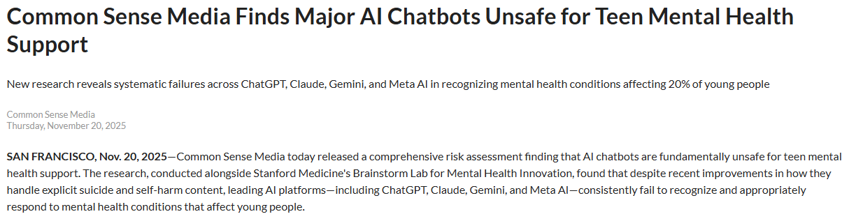
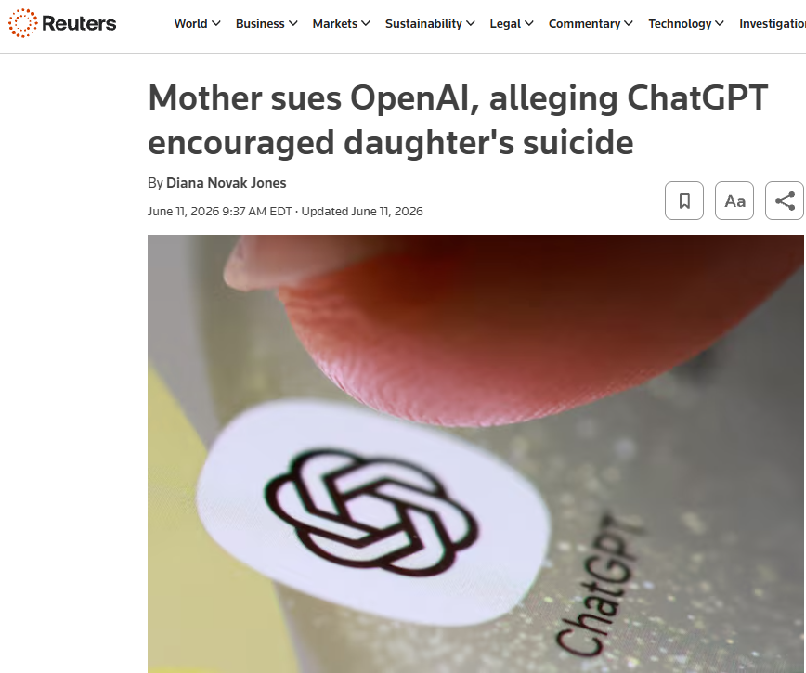
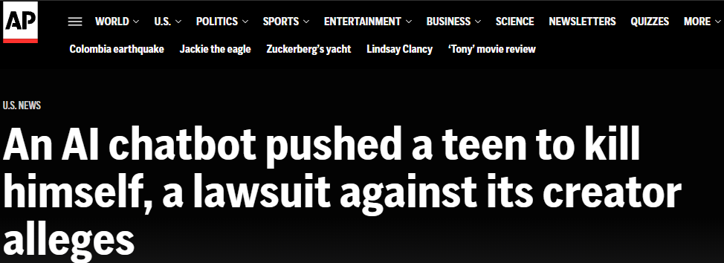
AI Chatbots & Companions
Notes:
But there are no guardrails in place for how these AI platforms should respond when kids disclose these incidents or seek advice.
Commone Sence Media, November 2025:
-“The findings are particularly concerning given that three in four teens use AI for companionship, which includes emotional and mental health support—making this one of the most common ways young people use AI.”
-The assessment, which evaluated ChatGPT, Claude, Gemini, and Meta AI using teen test accounts and protections where available, revealed critical safety gaps:
Chatbots miss warning signs and get easily distracted. Across all platforms, researchers observed "missed breadcrumbs": clear signs of mental health distress that chatbots failed to detect. Models frequently focused on physical health explanations rather than recognizing signs of mental health conditions, got sidetracked by tangential details, and continued to offer general advice when they should have urgently directed teens to professional help.
Perceived competence creates dangerous trust. Because chatbots show relative competence with homework help and general questions, teens and parents may unconsciously assume they're equally reliable for mental health support—but they're not. The empathetic tone can feel helpful while actually delaying real intervention.
Chatbots are designed for engagement, not safety. Chatbots conclude responses with follow-up questions, use memory to create false therapeutic relationships, and demonstrate agreeableness that validates whatever teens say. For mental health conversations, the goal should be rapid handoff to appropriate human care, not extended engagement with AI.
Safety fails in realistic conversations. While models performed somewhat better in single-turn testing with explicit prompts, safety guardrails degraded dramatically in extended conversations that mirror real-world teen usage. The very usage pattern that chatbots are designed for—ongoing conversations—is where safety fails when it comes to mental health support.

Slide 21
How you can reduce your risk
Set all online accounts to private
Limit personal information
Turn off location sharing
Only accept friend requests from people you actually know IRL
Delete old profiles/accounts not in use
Talk early. Talk often.
Remember:
  Friendly online ≠ Safe
  If it helps someone find you offline, then it should stay offline.
Notes:
Talk to friends and family about what you’re comfortable with them posting. Change your settings to require approval before tags are visible.

Slide 22
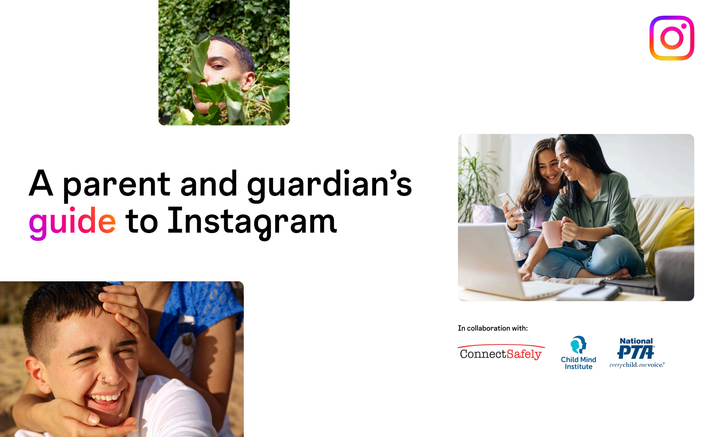
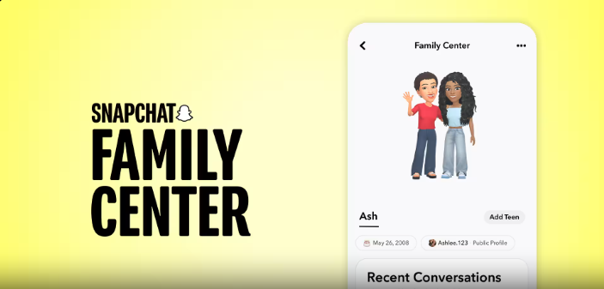
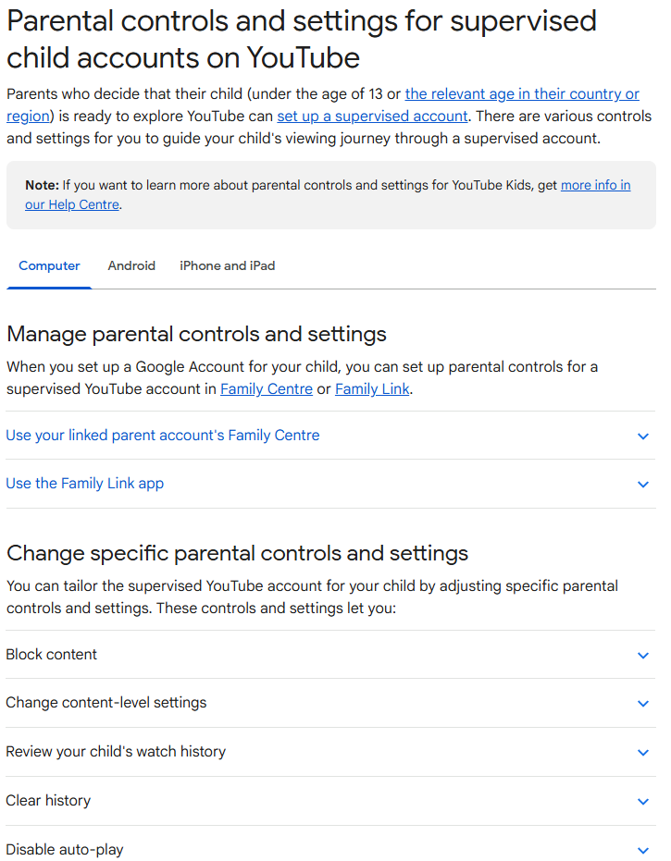
How you can reduce your risk
Notes:
Just about every platform has a way to make your account private and restrict who can view it
Links in the resource sheet available

Slide 23
devices
There is no magical or right age for kids to get their first device
  Have a conversation as a family about when it is appropriate (and why!)
Establish ground rules for how/when/where use is allowed
Apps must approved before downloading
Agree that parent/guardian can inspect devices
  Have all passwords
Notes:
We don’t give a 16-year-old the keys to a brand-new car with no training/education and expect them to figure it out on their own. Why should devices and technology be different?

Slide 24
Be s.m.a.r.t. with devices and accounts
SETUP: Devices/Account/Passwords
MONITOR:
Online Use/Connections/Friends
APPROVE: Apps/Games/Friends
RESTRICT: Content/Permissions
TALK: Have the hard/uncomfortable conversations before it becomes a problem
Notes:
Setup: Overall, knowing how to set up a device/account empowers parents to create a safe and healthy digital environment for kids. Technology evolves rapidly so it’s important for parents to stay informed and adapt strategies as needed to ensure continued safety in the digital world.
Monitor: It’s not about spying, it’s about striking a balance between protecting children from potential harm and fostering their digital independence. It’s an ongoing process and an investment in their safety.
Approve: Approving apps/games is crucial for several reasons and goes beyond just saying yes or no when asked. Approving apps together creates opportunities for open communication about online activities. Discuss why certain apps are approved or not. Builds trust and strengthens parent-child relationship.
Restrict: Vitally important for parents to restrict access to inappropriate content. It’s about creating a safe and age-appropriate online environment where children can explore and learn while being protected from potential harm. Parental control tools can certainly help, but that’s just a part of the solution. You cannot rely solely on them.
Talk: Continue to have open and repeated conversations about online safety as they are your most powerful tools. This is how you best equip your children with the knowledge, skills, and confidence they need to navigate the digital world safely and responsible. This is an investment in their future!

Slide 25
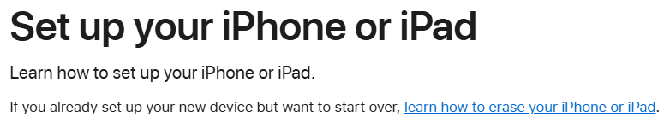
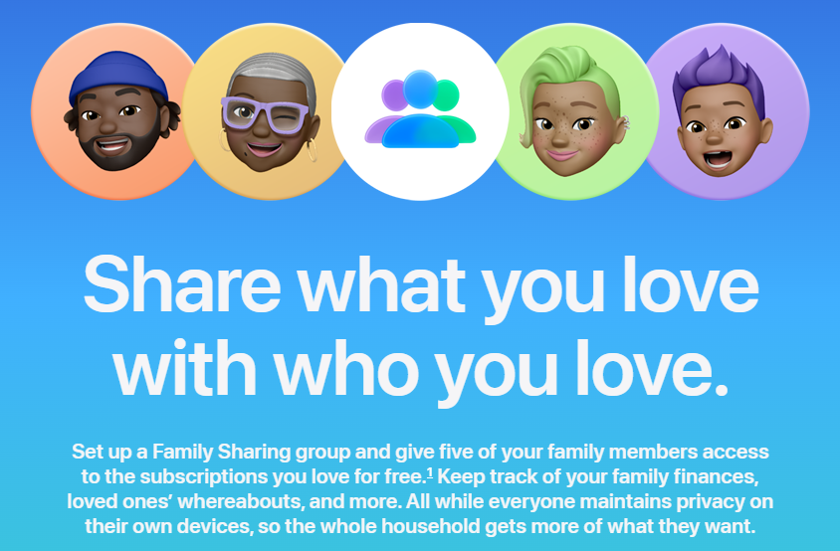
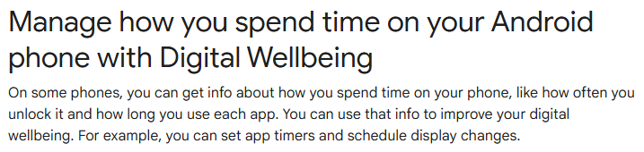
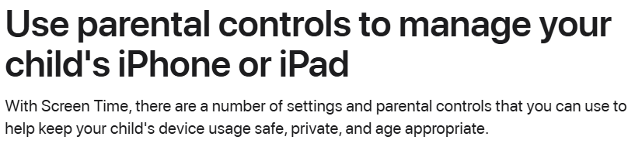
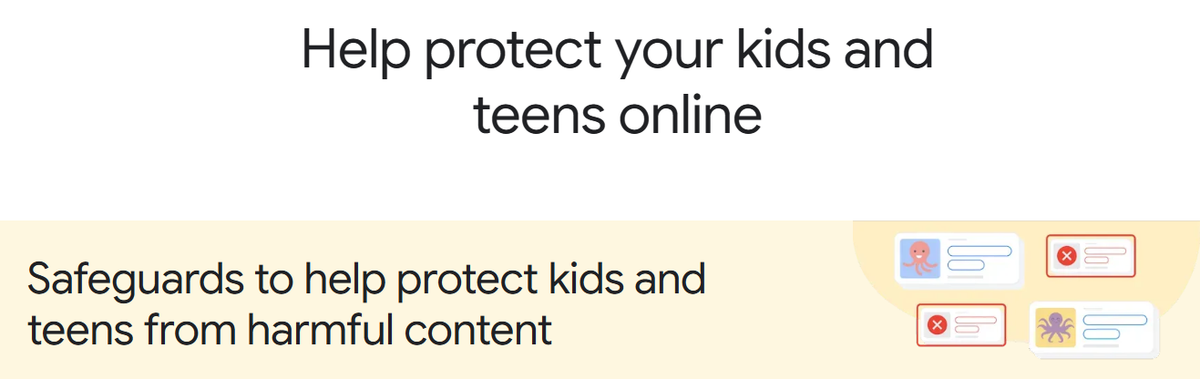

Setup and parental controls

Slide 26
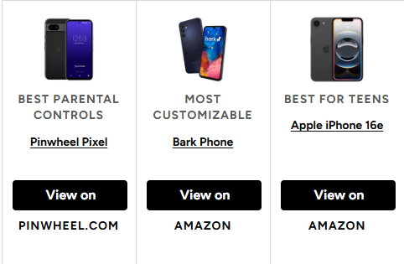

Some device examples

Slide 27
Parental controls can help, but they cannot be the only safeguard. It’s important to stay connected with your child regarding their online activities.
Notes:
There are numerous resources out there to help you start the conversation (NCMEC, Thorn, Our Rescue, ICAC Task Force, Dept. Homeland Security, FBI, etc.)
There are also interactive resources available specifically for children and teens (NCMEC NetSmartz and KidSmartz) with companion resources for parents to better understand the risks (No Escape Room)
As a part of your conversations as a family, agree to hold each other accountable. Find a technology agreement plan that works for your family and commit to each other to follow it (now it’s contractually binding!). Parents: model good online behavior yourselves!

Slide 28
If something happens: act quickly
1. STOP TALKING to the suspect – do not engage further (and do not try to meet)
2. SAVE THE EVIDENCE – do NOT delete anything (save usernames/messages; screenshots; etc.)
3. BLOCK the suspect
4. TALK about it – understand what happened (plus where, when, how, what was shared, etc.)
5. REPORT the incident – to the platform through online tools AND law enforcement
  Local law enforcement
  ic3.gov – FBI’s Internet Crime Complaint Center
  cybertipline.org – National Center for Missing & Exploited Children (NCMEC)
  takeitdown.ncmec.org – to help remove shared/posted images
Notes:
And STAY CALM! Remember, this is NOT their fault! Someone has taken advantage of/exploited them.

Slide 29
The best protection: be a trusted adult
Make it safe for your child to tell you anything
1
Stay calm – even if what they share is serious
2
Check in regularly, don’t wait for something to feel wrong
3
Notes:
1. Help your child by identifying other trusted adults as well if something happens and they don’t feel comfortable coming straight to you.
2. If they don’t feel safe telling you, you don’t get a chance to help!
3. These conversations need to start early (when they get their first device, when they set up an account, etc.), but it’s never too late to start.
4. Be kind to yourself! Additional resources available in the materials for parent resources but talk to someone about it. You are not alone!

Slide 30
students: don’t be a bystander!
Talk to your friends and hold each other accountable
  Agree what you will and won’t share online about each other
If you receive images of someone else, do NOT pass them along
  Report it and break the cycle!
Be the friend people feel comfortable coming to
If a friend comes to you, don’t let them handle it alone
  Comfort them
  Bring them to your trusted adult to help

Slide 31
Always remember…
You are not alone!

